Slide 1
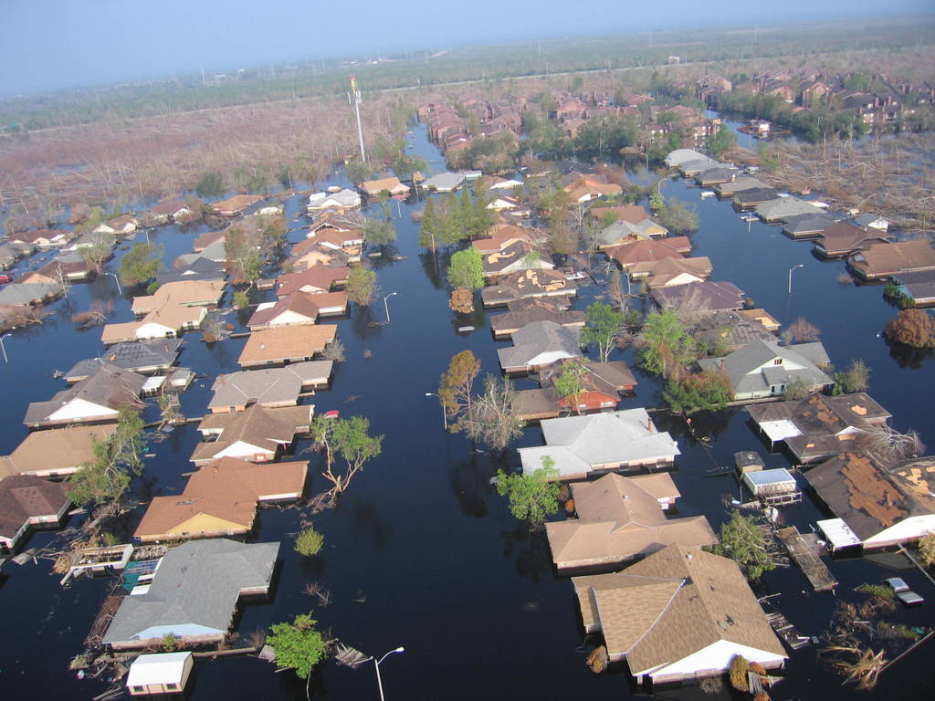
Unnatural Disasters

Slide 2
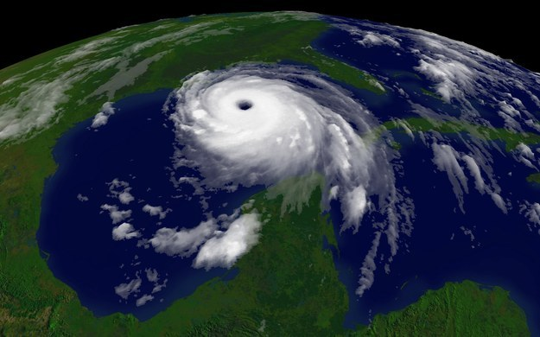

Slide 3
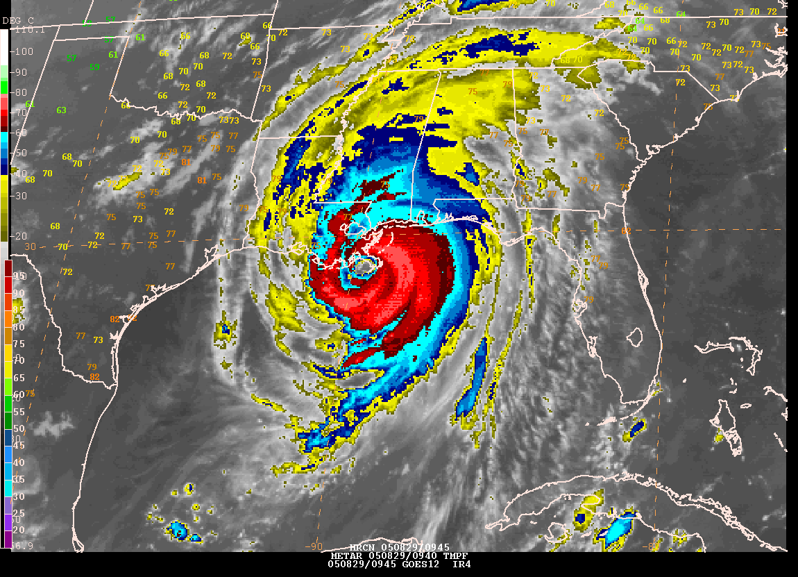

Slide 4
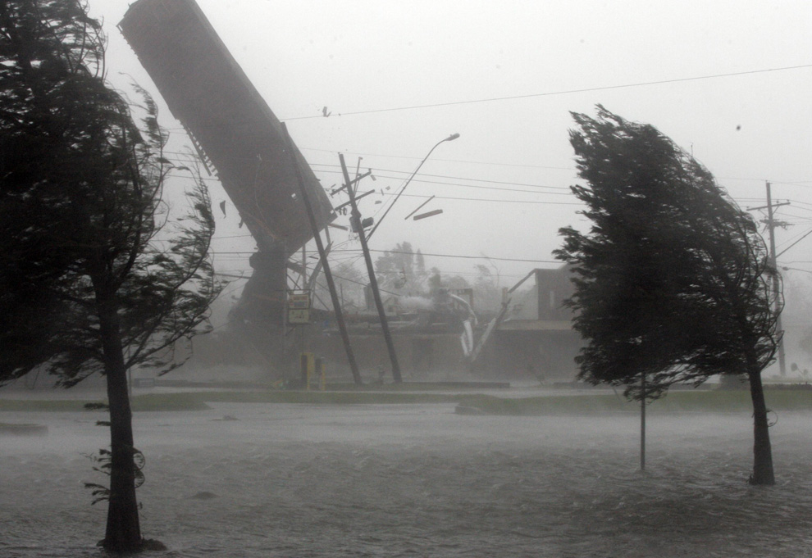

Slide 5
Hurricane
"rapidly rotating storm system characterized by a low-pressure center, a closed low-level atmospheric circulation, strong winds, and a spiral arrangement of thunderstorms that produce heavy rain. “
Source: Wikipedia.
Called ‘typhoons’ in Northern Pacific, and ‘cyclones’ in Indian Ocean

Slide 6
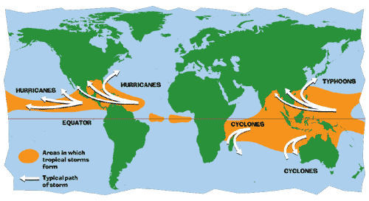

Slide 7
Six requirements
Warm sea surface temperature
Atmospheric instability
High humidity in lower to middle troposphere
Coriolis force to develop low pressure center
Pre-existing low-level focus or disturbance
Low vertical wind shear

Slide 9
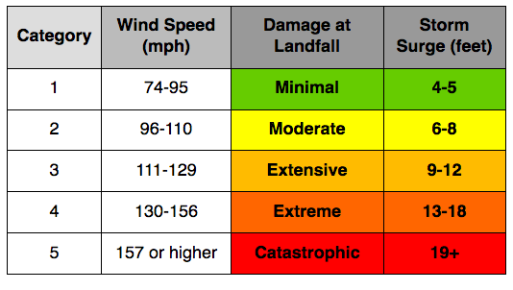

Slide 10
What was unnatural about the Hurricane Katrina disaster?

Slide 11
Methods: How do we study disasters?
History of dividing social science and natural science methods

Slide 12
Natural science
Meterology, seismology, etc.

Slide 13
Social sciences
History, anthropology, and sociology . . .

Slide 14
Unnatural disasters
Beyond the division of ‘nature’ and ‘society’
Disasters: interactions between the ‘natural’ and the ‘social’

Slide 15
Instructional Methods and Expectations
The seminar meets twice per week. Generally speaking, reading assignments will be due for Monday's class, and on Monday we will focus on discussing the reading and elucidating key concepts. The Thursday class will center on the case study of an actual disaster. Student groups will begin the seminar by presenting the facts of the case and appraising the social, cultural, political and technological factors that contributed to shaping the outcomes of disaster. The seminar will then proceed to apply the key concepts learned from that week's reading to the disaster case study. Sometimes discussion will be supplemented by other materials provided by the instructor, including films and guest speakers.
All required readings are available on eDimension. For group presentations, you will need to consult additional materials. Please consult with me and I can assist you in finding good sources. I also encourage you to work with the library staff.

Slide 16
Course Policies
Attendance is mandatory. More than one unexcused absence will result in a penalty of 5% reduction of the overall grade. More than three will result in a failing grade.
There will be no make-up quizzes or exams, unless the student has a valid medical or other emergency.

Slide 17
Academic Integrity
Students are expected to produce their own work, whether individually or in groups. Do not copy work from the internet or other published sources without proper citations. This is plagiarism and if a student is found to be doing so, he or she will be subject to disciplinary measures including potentially failing the course.
Plagiarism is the use of some one's intellectual work without acknowledgement. It is a serious offense. It is the policy of the university that students who plagiarize will be severely disciplined. Full acknowledgement for all information obtained from sources outside the classroom must be clearly stated in all written work submitted and in all oral presentations, including images or texts in other media and for materials collected online. All ideas, arguments, and direct phrasings taken from some one's work must be identified and properly footnoted. Quotations from other sources must be clearly marked as distinct from the student's own work.

Slide 18
Consultations
Office hours:
Wednesday, 12 noon, or by appointment.
Office: 1.402.18.

